Slide 1



SCAN ME !!
Team 10011
Thapar Institute of Engineering and Technology
Team Members:
Riya Sachdeva (www.github.com/riyasachdeva04)
Navdeep Singh Sidhu (www.github.com/navdeepsingh112)
Aditya Sapra (www.github.com/adityacodes30)
Mankirat Singh (www.github.com/MankiratSingh1315)

Slide 2
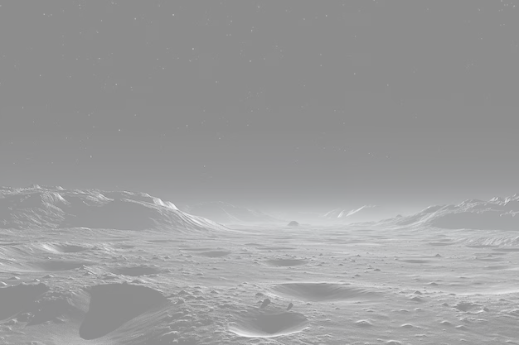


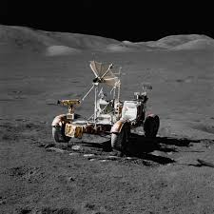
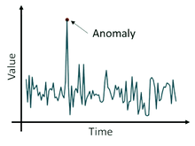
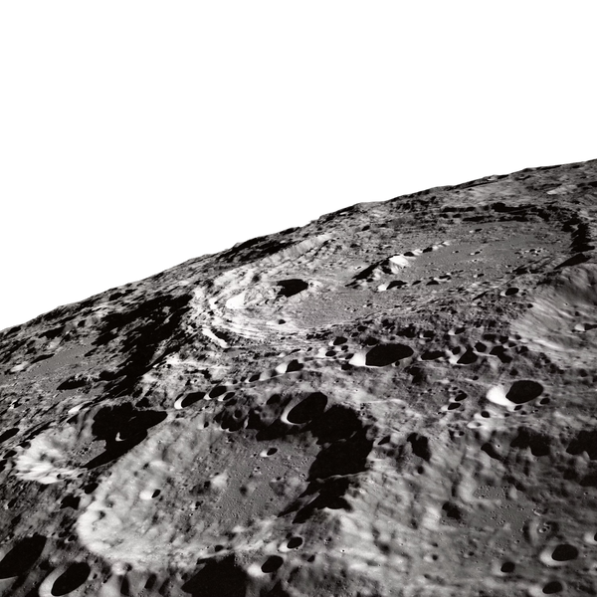


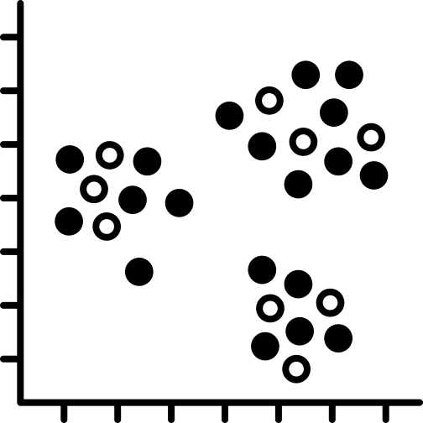

Features
SCAN ME !!
High-Resolution Data Integration
Anomaly Detection
Advanced Obstacle Detection
Optimal Path Planning
Scientific Region Identification
Geospatial Analysis and Visualization
Detailed Route Mapping

Slide 3

Regions of interest
SCAN ME !!
Hyperspectral Data collected from Imaging Infrared Spectrometer
Principal Component Analysis for Dimensionality rediuction
Find Regions of Interest using Outlier detection

Slide 4
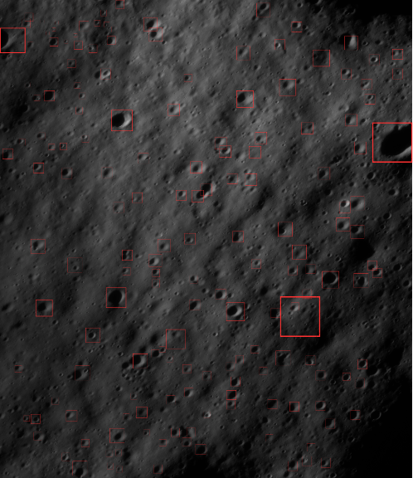
Craters & boulders
SCAN ME !!
Analyze 3D topographical data (DEM)
K-fold cross-validation + Vision transformer
Performance Evaluation

Slide 5
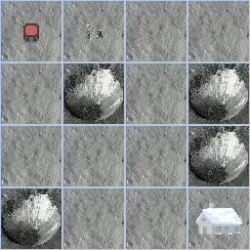
safe navigation to roi
SCAN ME !!
Hinderance Detection
Safe Navigation Grid through PPO
Dynamic Adjustments RLHF
Genetic Algorithm for multi parameter optimization

Slide 6
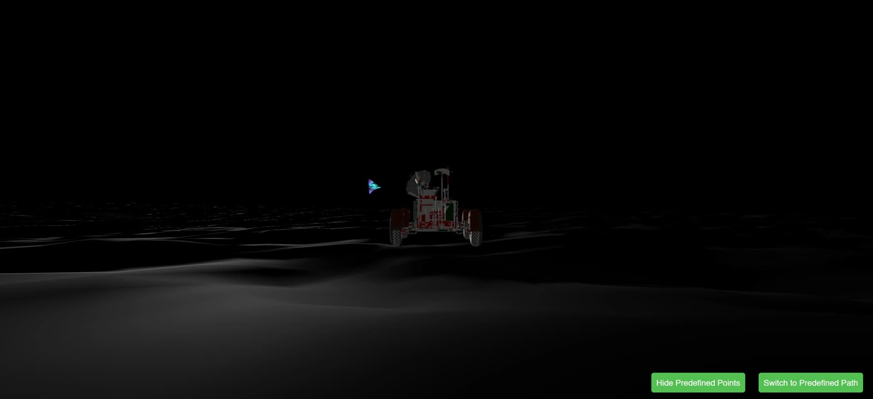
simulator
SCAN ME !!
TMC DEM + Ortho Simulation
Mark boulders craters detected
Mark Identified RL Path

Slide 7
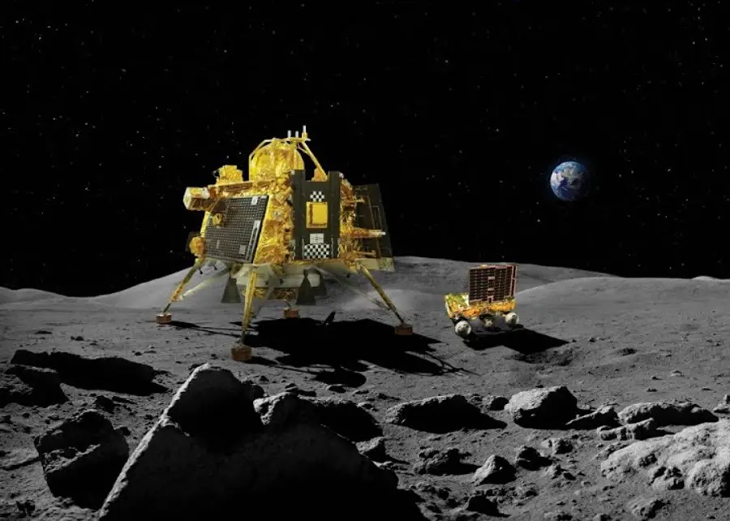
unique selling points
SCAN ME !!
01.
Versatile Anomaly Detection Engine
Adapts seamlessly to diverse spectral data, enabling identification of scientifically valuable regions across various celestial terrains.
02.
Robust Resource Identification
Precisely detects essential resources like water using targeted spectral analysis, vital for sustaining long-term extraterrestrial missions.
03.
Adaptive Hazard Navigation
Leverages advanced AI models to recognize and circumvent obstacles, ensuring safe traversal in unpredictable environments on the Moon, Mars, and beyond.
04.
Dynamic Path Optimization
Employs reinforcement learning to chart efficient routes, optimizing mission timelines and resource utilization across different planetary landscapes.
05.
Scalable Terrain Mapping Framework
Utilizes tensor-based representations adaptable to various terrains, facilitating deployment across multiple planetary bodies with minimal adjustments.

Slide 8

SCAN ME !!

